Slide 1

Black Friday Sales EDA
Flip Robo Technologies.
Submitted by:
Prashant Pathak(INT33)

Slide 2
Steps of EDA
Import all required modules and libraries.
Lode the train dataset and test dataset.
Marged both datasets using append method.
Used df.info() to know about the dataset.
Drop useless columns.
Handle categorical features
Handle missing values
Handle datatypes of each column
Visualizations of data

Slide 3
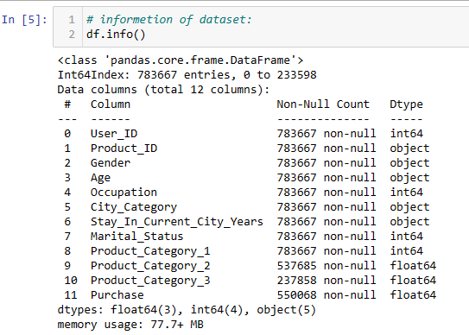
Data Information before processing

Slide 4
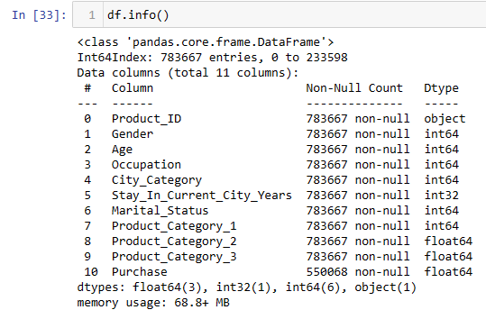
Data Information after processing

Slide 5
Visualizations

Slide 6
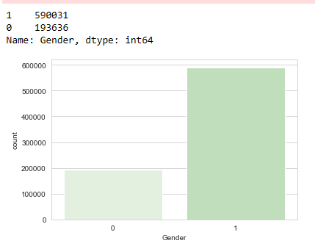
Count Vs Gender
Men purchase approx 3 times more than women. Is it possible? 😁

Slide 7
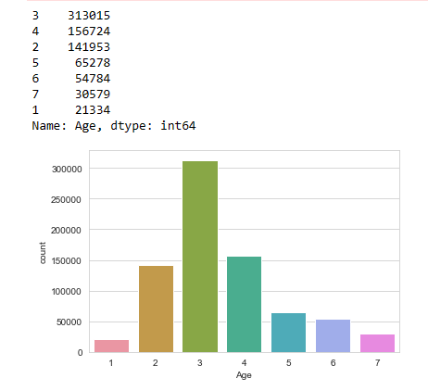
Count Vs Age
Young people are the biggest purchaser which age group is 26y – 35y.

Slide 8
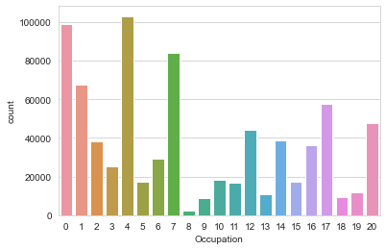
Count Vs Occupation
Occupation 4 is the biggest purchaser in occupation categories.

Slide 9
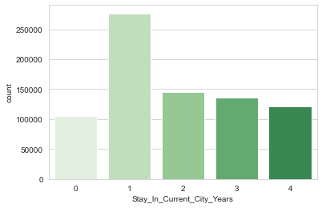
Count Vs Stay in current city
People who have stayed in current city for 1 year buy more things in the Comparision of others.

Slide 10
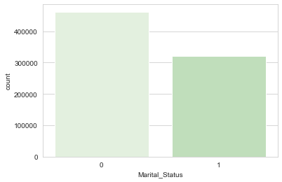
Count Vs Marital Status
Unmarried persons purchase more in Comparision of married persons.
This fact is interesting. 😄

Slide 11
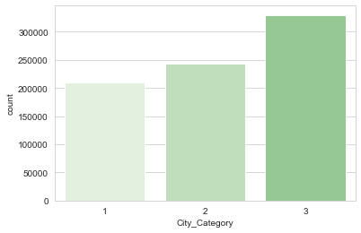
Count Vs City Category
City category “C” gets first rank of purchasing, and “B” gets second and “A” gets third. It means, citizens of city category “C” are good purchasers.

Slide 12
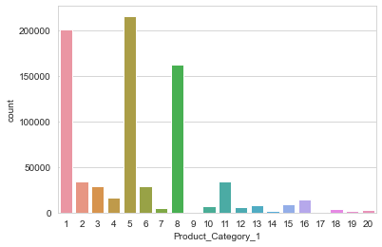
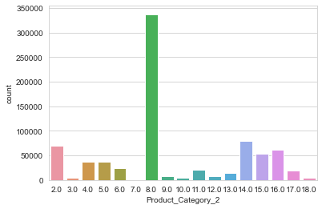
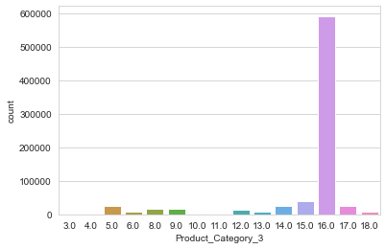
Count Vs Product categories
Most purchased item in Product category_1 is “5”.
Most purchased item in Product category_2 is “8.0”.
Most purchased item in Product category_3 is “16.0”.

Slide 13
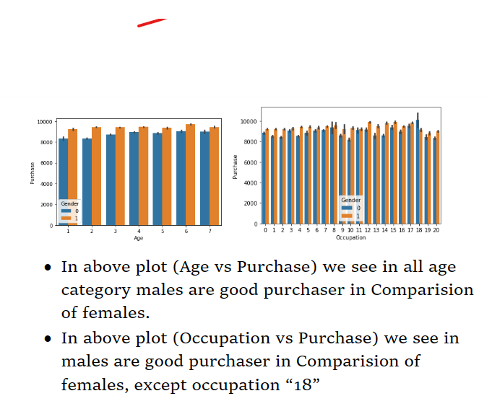
Purchase Vs Age Purchase Vs Occupation

Slide 14
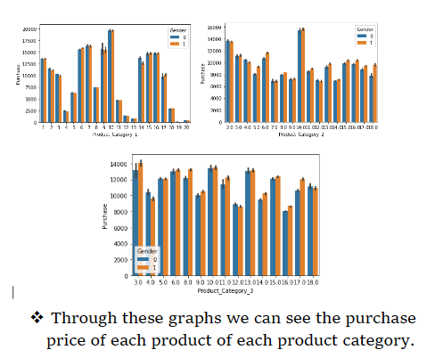
Purchase Vs Product Categories

Slide 15
The End...
Flip Robo Technolgies

